Slide 1
Real Algorithm
Just started

Slide 2
Write code following output below
Case 1
> 2
>​ A
AA
result =""
number = int(input())
text = input()
for i in range(number):
result += text
print(result)
Case 2
> 5
> B
BBBBB

Slide 3
Write code following output below
Case 1
> 2
>​ 4
> AB
AABBBB
Result =""
result =""
n1 = int(input("Input your number: "))
n2 = int(input("Input your number: "))
text = input("Input your text: ")
for i in range(n1):
result += text[0]
for j in range(n2):
Result += text[1]
print(result+Result)
ONLY 2 LETTER ALLOW
Case 2
> 5
> 2
> EF
EEEEEFF

Slide 4
Write code following output below
Result =""
result =""
n1 = int(input())
n2 = int(input())
text = input()
for i in range(n1):
Result += text[0]
for j in range(n2):
result += text[1]
print(Result+result)
Case 1
> 2
>​ 4
> AB
AABBBBBBBB
ONLY 2 LETTER ALLOW
Case 2
> 2
> 2
> EF
EEFFFF

Slide 5
Write code following output below
Case 1
> 4
>​ Enter: 2
>​ Enter: 4
>​ Enter: 4
>​ Enter: 6
Sum: 16
Sum = 0
Number = int(input())
for i in range(Number):
N1 = int(input("Enter:"))
Sum += N1
print("Sum:", Sum)
Case 2
> 2
>​ Enter: 2
>​ Enter: 4
Sum: 6

Slide 6
Write code following output below
Result =""
for i in range(4):
Text = input("Enter:")
Result += Text + ","
print("Result:", Result[:-1])
Case 1
>​ Enter: Hello
>​ Enter: Hi
>​ Enter: Morning
>​ Enter: Good night
Result: Hello, Hi, Morning, Good night
Allow only one print
Case 2
>​ Enter: Yes
>​ Enter: Hi
>​ Enter: Not well
>​ Enter: Okay
Result: Yes, Hi, Not well, Okay

Slide 7
Write code following output below
Case 1
>​ Enter: abc93sa
Number: 93
Text: abcsa
N =""
T =""
text = input()
for i in range(len(text)):
if text[i].isnumeric():
N = N + text[i]
else:
T = T + text[i]
print("Number:", N)
print("Text:", T)
Case 2
>​ Enter: 192abcfj99
Number : 19299
Text: abcfj

Slide 8
Write code following output below
Case 1
>​ Enter: abc93sa
Sum: 12
Text: abcsa
sum = 0
result =""
nt = input()
for i in range(len(nt)):
if nt[i].isnumeric():
sum += int(nt[i])
else:
result += nt[i]
print("Sum:", sum)
print("Text:", result)
Case 2
>​ Enter: 192abcfj99
Sum : 30
Text: abcfj

Slide 9
Write code following output below
Case 1
>​ Enter: 98473521
12345789
Case 2
>​ Enter: 1923849
1234899

Slide 10
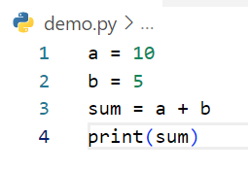
Write step following code below
Step | a | b | sum | output
1 | 10
2 | 10 | 5
3 | 10 | 5 | 15
4 | 10 | 5 | 15 | 15
Example

Slide 11
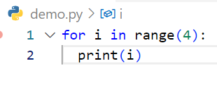
Write step following code below
Step | i | output
1 | 0 | 0
2 | 1 | 1
3 | 2 | 2
4 | 3 | 3

Slide 12
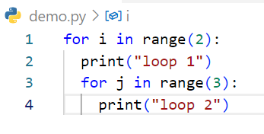
Write step following code below
Step | i | j | output
1 | 0 | 0 1 2 | Loo1 Loop2 Loop2 loop2
2 | 1 | 0 1 2 | Loop1 Loop2 Loop2 Loop2

Slide 13
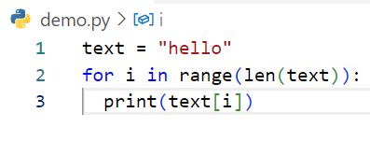
Write step following code below
Step | text | i | output
1 | hello
2 | hello | 0 | h
3 | hello | 1 | e
4 | hello | 2 | l
5 | hello | 3 | l
6 | hello | 4 | o

Slide 14
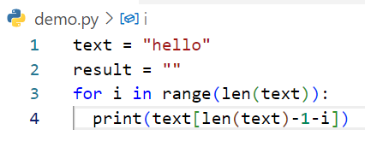
Write step following code below
Step | i | text | result | output
1 |  | hello
2 |  | hello | “ ”
3 | 0 | hello | “ ” | o
4 | 1 | hello | “ “ | l
5 | 2 | hello | “ “ | l
6 | 3 | hello | “ “ | e
7 | 4 | hello | “ “ | h

